Slide 1



Capnospot® - Improving Trauma Care
Clinical Implementation Guideline

Slide 2


Objectives
Understand the role of Capnospot® in the treatment of tension pneumothorax
Identify the signs and symptoms of tension pneumothorax in the self ventilating patient
Identify the signs and symptoms of tension pneumothorax in the patient who is receiving positive pressure or that is mechanically ventilated
Landmark the 2nd intercostal space, midclavicular line
Landmark the 4th/5th intercostal space, anterior axillary line
Insertion of a needle decompression device with Capnospot®
Observing for signs and symptoms of clinical improvement after relief of tension pneumothorax with Capnospot®
Troubleshooting the Capnospot® and identification of catheter failure

Slide 3
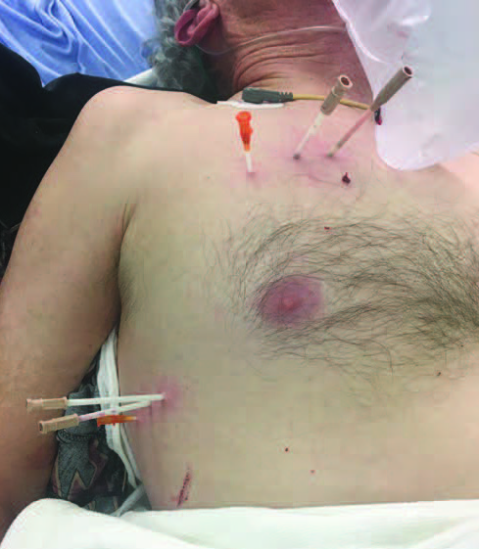

The Why of Capnospot®
Patients arrived in the trauma bay looking like this!
If this is what happens at leading medical centers, what happens in other places
What is the Pre-Hospital solution? Is there a better way

Slide 4
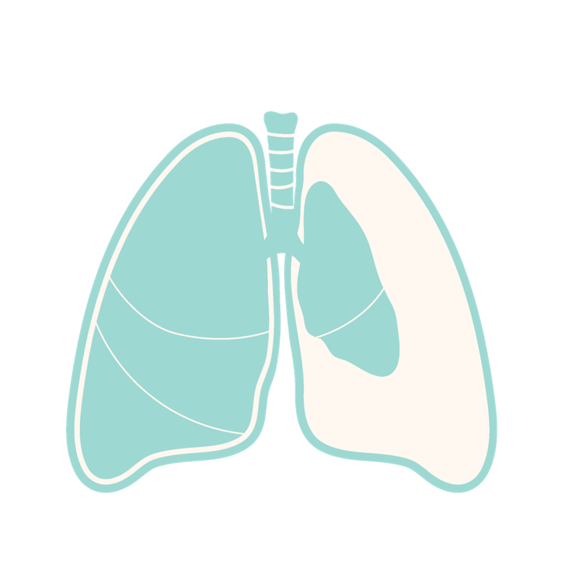
The Clinical Problem: Tension Pneumothorax
100% fatality rate if not treated immediately
30% of preventable trauma mortalities occur from tension pneumothorax ⁽¹⁾
Civilian Incidence “unclear” ⁽²⁾
      Somewhere between 1% - 20%
DOD ~3-4% of all combat mortalities⁽¹⁾
Prehospital Decompression Reduces 24-hour Mortality by 25%⁽²⁾
1. J. J. McPherson, D. S. Feigin, R. F. Bellamy, Prevalence of Tension Pneumothorax in Fatally Wounded Combat Casualties, J. Trauma Inj. Infect. Crit. Care 60, 573–578 (2006).
2. Muchnok D, Vargo A, Deeb AP, Guyette FX, Brown JB. Association of Prehospital Needle Decompression With Mortality Among Injured Patients Requiring Emergency Chest Decompression. JAMA Surg. 2022 Oct 1;157(10):934-940. doi: 10.1001/jamasurg.2022.3552. PMID: 35976642; PMCID: PMC9386601.

Slide 5

The Current Standard of Care Fails Often
Thoracostomy catheter decompresses air in the thoracic cavity
Gold Standard = Listen for a “gush of air”
  Clinician: “Wait… did it work?”
Needle Thoracostomy failure rate of 20-50%⁽³⁻⁴⁾
3. J. M. Aho, C. A. Thiels, M. M. El Khatib, D. S. Ubl, D. V Laan, K. S. Berns, E. B. Habermann, S. P. Zietlow, M. D. Zielinski, Needle thoracostomy: Clinical effectiveness is improved using a longer angiocatheter., J. Trauma Acute Care Surg. 80, 272–7 (2016).
4. D. V Laan, T. D. N. Vu, C. A. Thiels, T. K. Pandian, H. J. Schiller, M. H. Murad, J. M. Aho, Chest wall thickness and decompression failure: A systematic review and meta-analysis comparing anatomic locations in needle thoracostomy., Injury 47, 797–804 (2016).

Slide 6
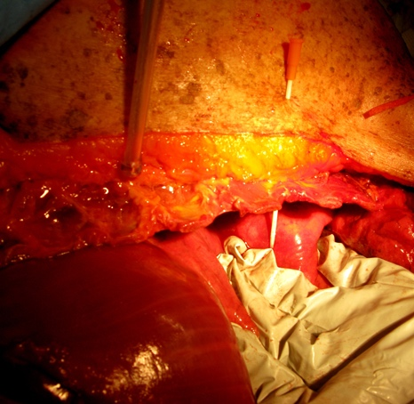
Why is the Failure Rate so High?
    The catheters are not large enough – 18ga → 16ga → 14ga → 10ga?
    Catheters are not long enough – 5 cm → 8 cm
    The chest is too thick! - 2nd ICS → 4th/5th MAL/AAL
    Training issues & “High Acuity, Low Occurrence Procedure”
    Failure Rate remains in most series 20-50% ⁽³⁻⁴⁾
    Hearing a “gush of air” as confirmation of correct placement and relief of a tension pneumothorax
3. J. M. Aho, C. A. Thiels, M. M. El Khatib, D. S. Ubl, D. V Laan, K. S. Berns, E. B. Habermann, S. P. Zietlow, M. D. Zielinski, Needle thoracostomy: Clinical effectiveness is improved using a longer angiocatheter., J. Trauma Acute Care Surg. 80, 272–7 (2016).
4. D. V Laan, T. D. N. Vu, C. A. Thiels, T. K. Pandian, H. J. Schiller, M. H. Murad, J. M. Aho, Chest wall thickness and decompression failure: A systematic review and meta-analysis comparing anatomic locations in needle thoracostomy., Injury 47, 797–804 (2016).

Slide 7

Needle Decompression: The Field Hamster Wheel
Indeterminate Outcome
Questionable Vital Sign Improvement
Repeat Procedure
Needle Decompression

Slide 8

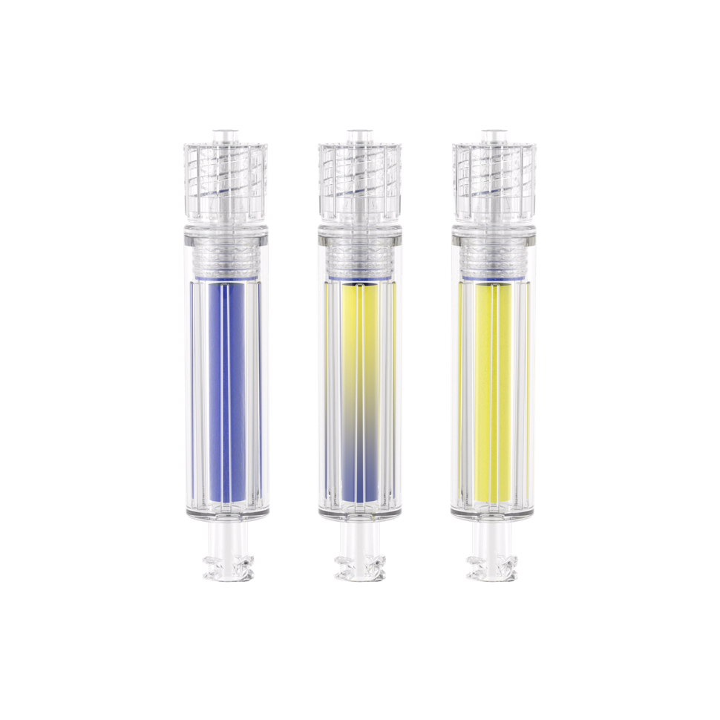
Capnospot® - Overview
The pneumothorax contains CO_{2.}
Indicates visually if decompression was successful or not within seconds, allowing immediate adjustment of the catheter
Objective confirmation of decompression by detecting CO2 from the pneumothorax and showing an obvious color change to the operator.
Compatible with all decompression devices and is easy to attach with a standard Luer fitting. Small, lightweight, and compact, and functions in low-light environments.
Notes:
Clarity Capnospot™ indicates visually if decompression was successful or not within seconds, allowing immediate adjustment of the catheter. Accuracy Capnospot™ provides objective confirmation of decompression by detecting CO2 from the pneumothorax and showing an obvious color change to the operator. Versatility Capnospot™ is compatible with all decompression devices and is easy to attach with a standard luer fitting. Capnospot is small, lightweight, and compact, and functions in low-light environments.

Slide 9
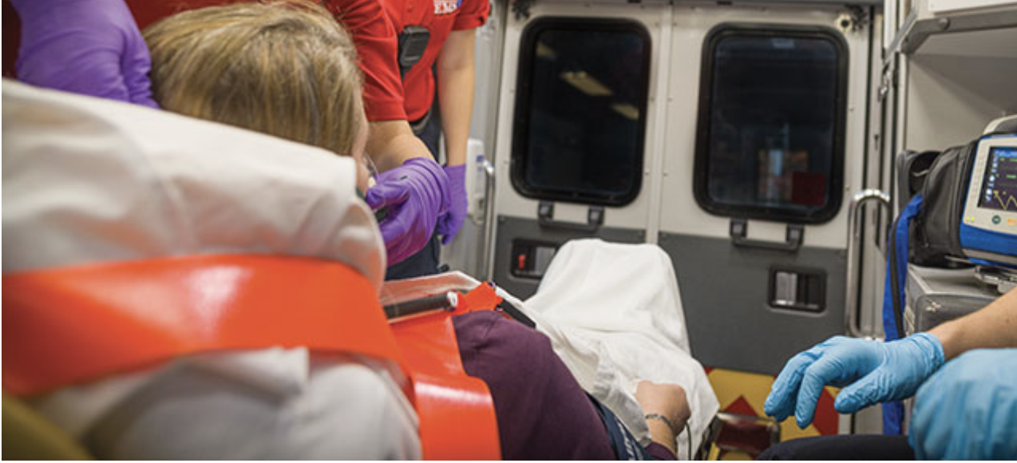
Signs and Symptoms of a Tension Pneumothorax
in a Self Ventilating Patient
  Tension pneumothorax detected via advanced imaging, clinical suspicion, or known traumatic injury to the chest, back, or abdomen, with severe or progressive respiratory distress associated with at least one or
  more of the following signs and symptoms^{3,4}:
  Severe or progressive tachypnea
  Severe or progressive dyspnea
  Tachycardia
  SpO₂ < 90%
  Absent or diminished lung sounds on the affected side
  Hypotension
  Persistent loss of consciousness
  Traumatic cardiac arrest without obviously fatal wounds

Slide 10
Signs and Symptoms of a Tension Pneumothorax in a Patient
Receiving Positive Pressure or Mechanical Ventilation
  Tension pneumothorax detected via advanced imaging, clinical suspicion, or known traumatic injury to the chest, back, or abdomen, and at least two or more of the following symptoms presenting with a rapid onset^{3,4}:
  Severe and progressive respiratory distress in the conscious self-ventilating patient (CPAP or Bi-level Ventilation)
  Severe or progressive tachypnea during administration of CPAP or Bi-Level Ventilation
  Tachycardia
  SpO₂ < 90%
  Hypotension

Slide 11
Signs and Symptoms of a Tension Pneumothorax in a Patient
Receiving Positive Pressure or Mechanical Ventilation (continued)
  Decrease of compliance during ventilation
  Acutely increased or progressive ventilatory requirements
  Subcutaneous emphysema
  Absent or diminished lung sounds on the affected side
  Loss of consciousness (while receiving CPAP or Bi-level Ventilation)
  Cardiac arrest without other known etiology

Slide 12
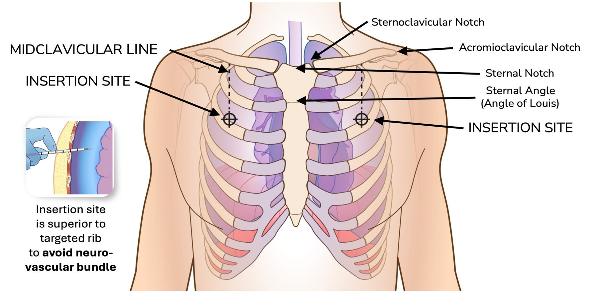
Identifying the 2nd Intercostal Space,
Mid Clavicular Line
Notes:
To Identify the 2nd intercostal Space Mid Clavicular Line, proceed with the following steps
Identification of the sternal notch (Figure 1)
Identification of the sternoclavicular joint (Figure 1)
Identification of the acromioclavicular joint (Figure 1)
Identification of the clavicle mid-point (midclavicular line)
Identification of the 2nd intercostal space (above the third rib – midclavicular line, at the sternal ridge, or sternal Angle of Louis) (Figure 1)
Identify the intersection between the vertical midclavicular line and a horizontal line running laterally from the Angle of Louis (Figure 1)
Confirm location by firmly palpating the 3rd rib on the midclavicular line (Figure 1)
Cleanse the site by applying antiseptic wipe or solution if available

Slide 13
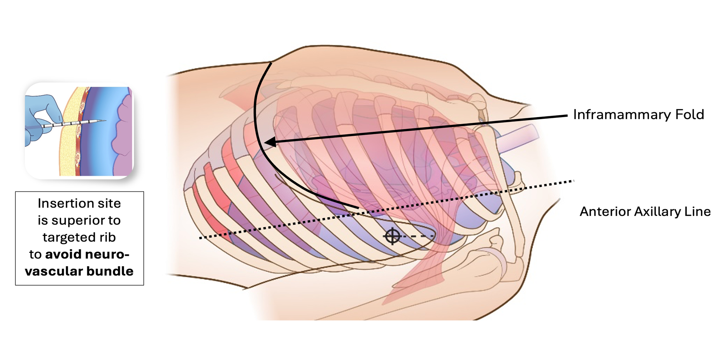
Identifying the 4th/5th Intercostal Space,
Anterior Axillary Line
Notes:
To Identify the 4th/5th Intercostal Space Anterior Axillary Line, proceed with the following steps
Identify the Inframammary fold
Moving laterally, the landmark is immediately behind the edge of the pectoralis major muscle
Cleanse the site by applying antiseptic wipe or solution if available

Slide 14
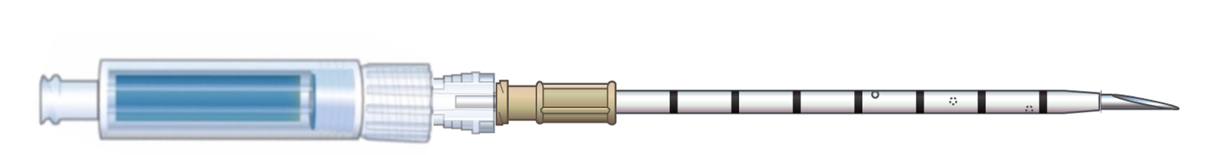
Prepare Equipment
Affix Capnospot® to decompression needle or catheter by connecting the male leur taper to the female connector. If a luer lock is present turn the luer lock fitting by turning clockwise
In addition to providing visual confirmation of tension physiology, the Capnospot® also functions as a one-way valve

Slide 15
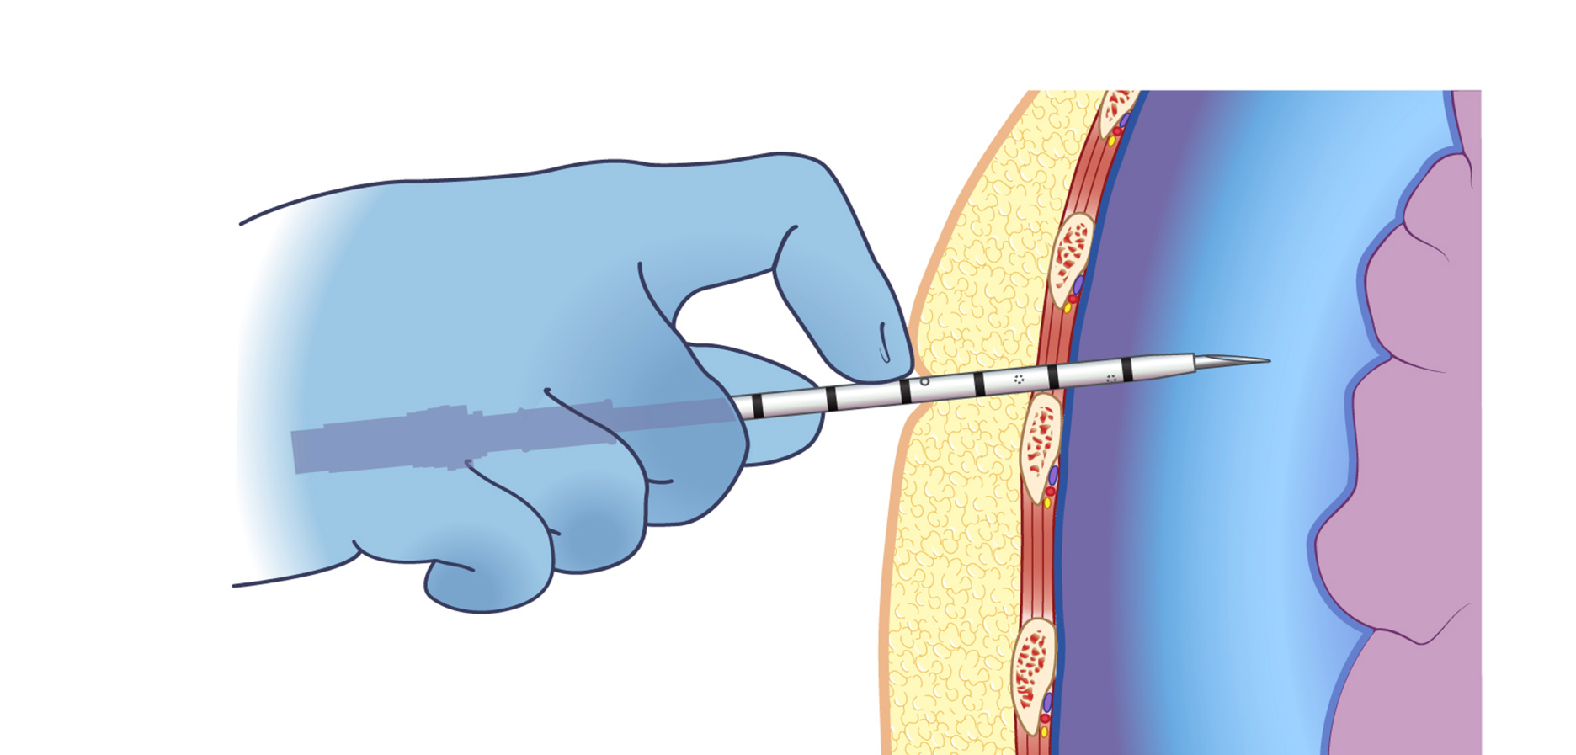
Insert the Decompression Device With Capnospot Affixed to Needle
Notes:
Penetrate the skin advancing the decompression device at a 90-degree angle through the chest wall just above the rib and into the plural space .

Slide 16
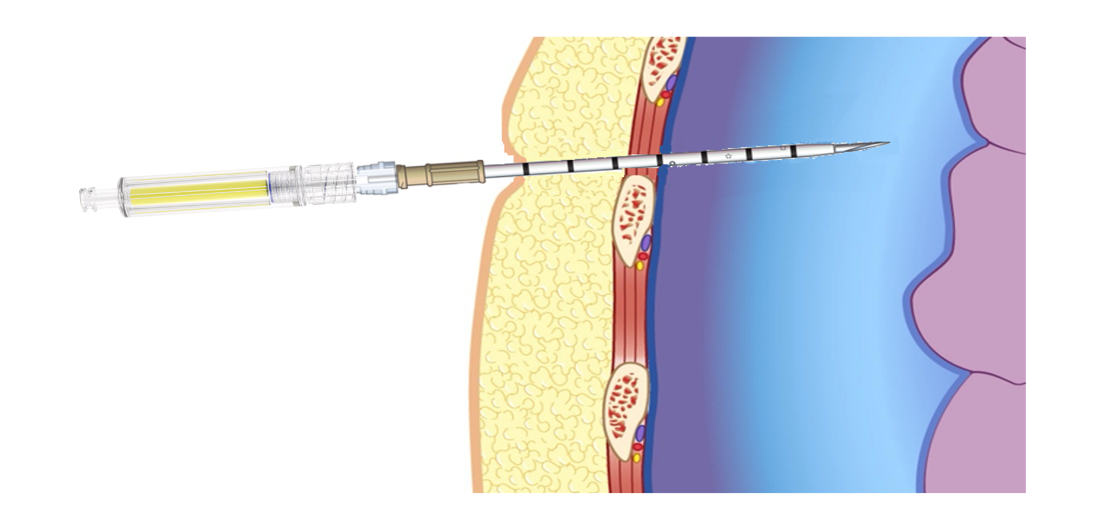
Advancing the Decompression Device
Evaluate for color change from blue to yellow in the Indication Chamber
Notes:
Advance the catheter through the chest wall until a positive indication of CO₂ is observed via Capnospot® or a “pop” is felt upon entering the plural space
Hold the decompression device in place for approximately 10 seconds and observe for visible color change in the Capnospot® indication chamber. Even If no observed color change proceed to step 3
Advance the catheter hub of the decompression device over the needle to the plane of the patient’s skin

Slide 17
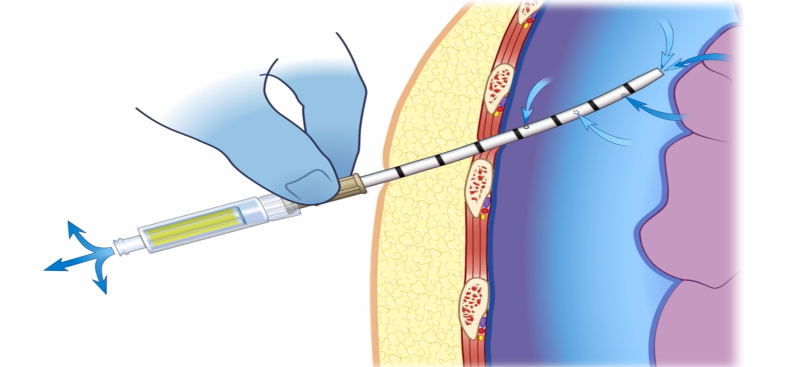
Continued Monitoring of Catheter Patency and Patient Improvement
Reapply Capnospot® to decompression catheter for continued assessment of catheter patency
Notes:
Reapply the Capnospot® to the catheter for ongoing assessment of catheter patency based on the color changing indicator (Figure 6)⁵
Secure the catheter per institutional policy
Monitor Capnospot® for continuous confirmation of catheter patency by visualization of a yellow color within color changing indicator⁵
Increase in SPO₂; Improvement of patient blood pressure; improvement of tachypnea and shortness of breath^{3,4,7}

Slide 18
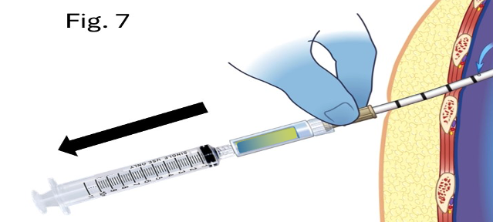
Trouble Shooting Capnospot and Evaluating Catheter Patency
If the Capnospot® color changing indicator presents a blue color, attach a 10mL syringe to the female luer connection of Capnospot® and attempt to aspirate air⁽⁵⁾. If the Capnospot® does not change to a yellow color or air is unable to be aspirated without resistance, evaluate the catheter for displacement or obstruction.
Notes:
If catheter displacement occurs, evaluate the patient for further clinical deterioration and consider the placement of a second commercially available decompression device with Capnospot® affixed^{3–5,9}
The Capnospot® may be kept in place to confirm catheter patency until definitive care is reached⁵
Needle Aspiration of Primary Spontaneous Pneumothorax
M. Pasquier, O. Hugli, and P.-N. Carron
New England Journal of Medicine
Volume 368 • Number 19 • May 9, 2013

Slide 19

THANK YOU
WWW.PNEUMERIC-MEDICAL.COM

